Slide 1
Comp Photography
Final Project
Deliang Yin
Fall 2017
deliang.yin@gatech.edu
Computational Photography @ GT

Slide 2
Image Colorization
Project Description: This project is proposed to replicate the colorization algorithm presented in the paper Colorization using Optimization by A. Levin, D. Lischinski, and Y. Weiss.
This project is to colorize the black-and-white images marked with color scribbles. In addition, I extended the scope to colorize black-and-white video clips.
Computational Photography @ GT

Slide 3
The Goal of Your Project
Original project scope:
Given a grayscale image marked with some color scribbles, the presented algorithm is able to colorize the image. The colorized image is then compared to the original color image.
What motivated you to do this project?
In my childhood, I saw some funny black-and-white movies, such as the ones performed by Charles Spencer Chaplin. At that time, I had a dream to colorize them using the modern colors, and this left me a room for imagination. After learning computational photography, I am finally equipped necessary skills to fulfill my child dream.
Computational Photography @ GT

Slide 4
Scope Changes
Did you run into issues that required you to change project scope from your proposal?
No, I haven't met issues during replication. However, when I finished colorizing still black-and-white images, I still got time remaining before the deadline. As such, I extended the scope to colorize black-and-white video clips.

Slide 5
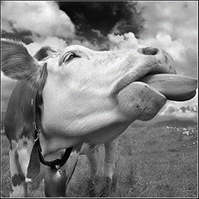
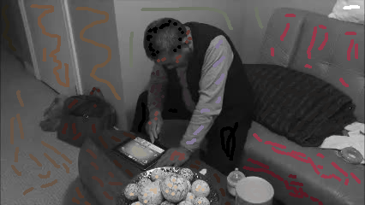
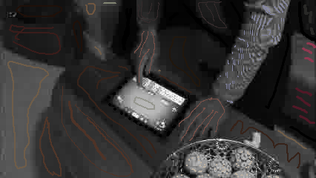
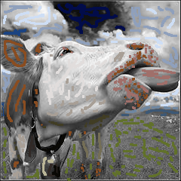
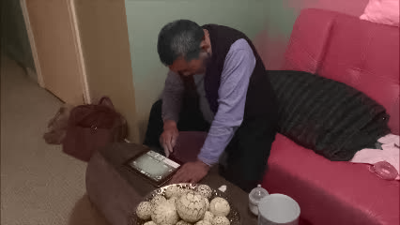
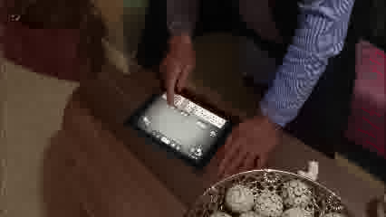
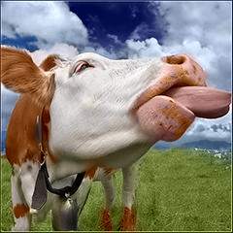
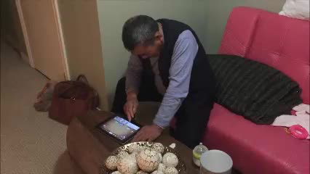
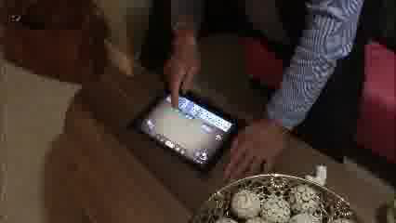
Showcase
To colorize still image
To colorize black-and-white video clips
Input 1: black and white image
Input:
marked image
Input 2: marked Image
Output:
colorized image
Output: colorized Image
Compared to original image
Computational Photography @ GT

Slide 6
Project Pipeline
Input BW image and marked images in RGB
Convert from RGB to YUV format
Find the marked area
Calcualte weights in a neighbor
Find matrix A and vector b
Solve Ax=b
Manual
Automatic
Convert from YUV to RGB
To colorize still images
Show your major functions and algorithms.
Explain your steps for the project as you actually completed it.
Indicate which steps are part of your automatic pipeline, and which are manual.
Output
Computational Photography @ GT

Slide 7
Demonstration: Result Sets
First I tested my code based on the set of images presented in the paper. After successfully replicated the results, I tested my codes based on four sets of my own images, downloaded online.
Dropbox links to test images:
https://www.dropbox.com/sh/b38gnbpgjp737h8/AAD-mae1x2mGW0dUNZd6Hqjoa?dl=0
Computational Photography @ GT

Slide 8
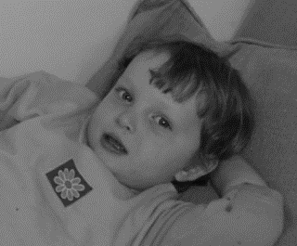
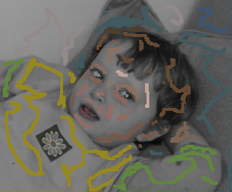
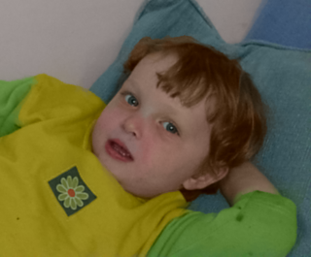
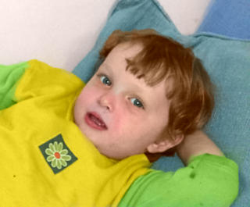
Demonstration: Result Sets
Input 1: black and white image
Input 2: marked image
Output: colorized image
Compared to original image
Computational Photography @ GT

Slide 9
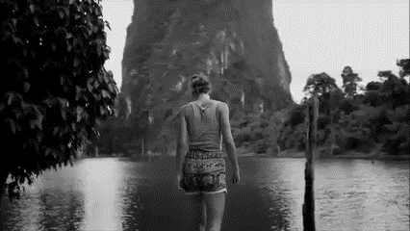
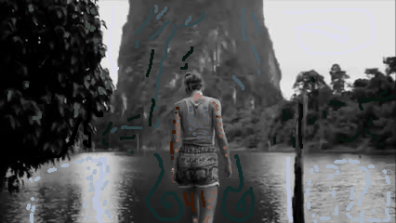
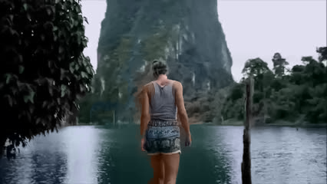
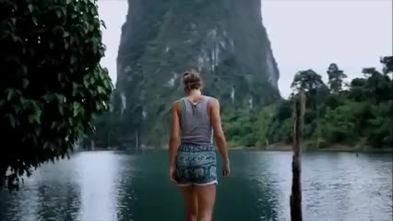
Demonstration: Result Sets (cont’d)
Input 1: black and white image
Input 2: marked image
Output: colorized image
Compared to original image
Computational Photography @ GT

Slide 10
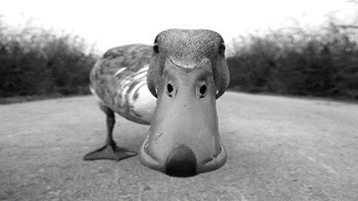
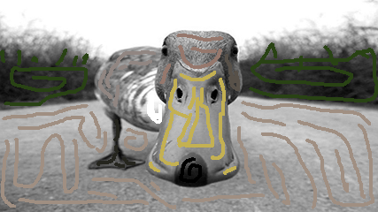
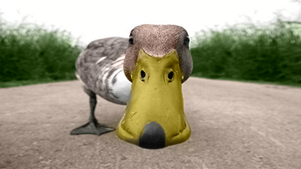
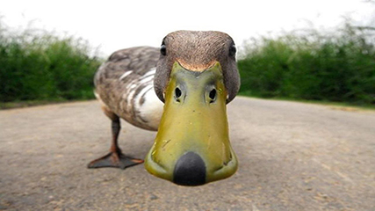
Demonstration: Result Sets (cont’d)
Input 1: black and white image
Input 2: marked image
Output: colorized image
Compared to original image
Computational Photography @ GT

Slide 11
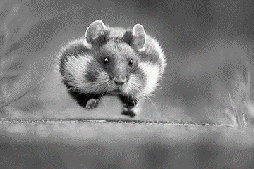
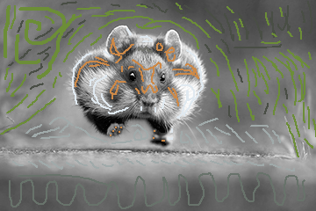
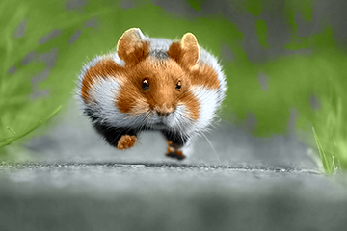
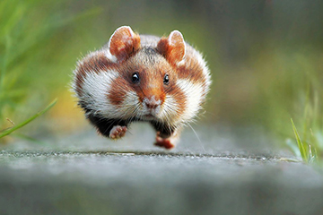
Demonstration: Result Sets (cont’d)
Input 1: black and white image
Input 2: marked image
Output: colorized image
Compared to original image
Computational Photography @ GT

Slide 12
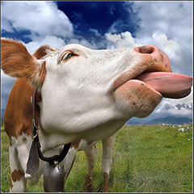
Demonstration: Result Sets (cont’d)
Input 1: black and white image
Input 2: marked image
Output: colorized image
Compared to original image
Computational Photography @ GT

Slide 13
Project Development
Use several slides for a detailed discussion of how you developed your project outputs. Tell your story. Difficulties with developing your code may also be discussed here, or in the following Computation section.
Include:
Narrative of your progress and issues you faced.
Include descriptions of problems, and how you handled them.
Include both good and failed interim results (from various parts of your work and pipeline)
Include a high level of details.
What would you do differently?

Slide 14
Project Development – Image Colorization
Purpose: to colorize still black-and-white image
Step 1: Take a colored image, and convert it to black-and-white
Convert the colored image into YUV format
Keep only intensity channel Y, and ignore the color channels U and V
Convert the Y channel back to RGB channel
Save to black-and-white image
Note: see function RGB_to_gray for coding details

Slide 15
Project Development – Image Colorization
Step 2: Manually mark the black-and-white image using color scribbles
I used MS paint to mark the black-and-white image. At the same time, I open the color image in Photoshop to get the color information (i.e. R, G, B values). With these RGB values, I used the paint to mark the gray image with color scribbles.

Slide 16

Project Development – Image Colorization
Step 3: To convert the black and white images from $RGB$ format to $YUV$ format, where $Y$ stands for intensities, and $U$ and $V$ contain relevant color information.
$$Y = 0.299×R + 0.587×G + 0.114×B$$
$$U = −0.147×R − 0.289×G + 0.436×B$$
$$V = 0.615×R − 0.515×G − 0.100×B$$
Note: the coefficients above are based on paper by Jack 2001 (see Source slide)

Slide 17
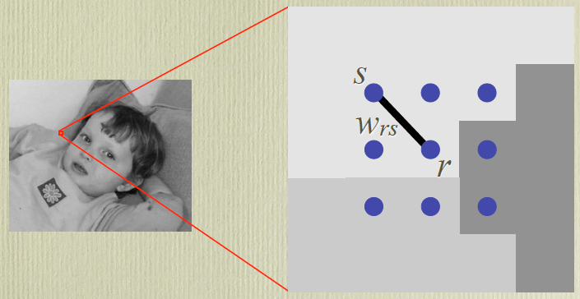

Project Development – Image Colorization
Step 4: To find the matrix U such that J(U) is minimized:
$$J(U)=\sum_{∀r∈Image}{{\left(U\left(r\right)− \sum_{s∈N\left(r\right)}{ω_{rs}×U\left(s\right)} \right)}^{2}}$$
Subject to constraints: $U\left[r_{m}\right]=u_{m}$, where $r_{m}=\left[i_{m},j_{m}\right]$ are all marked pixels and $u_{m}$ are pre-specified marked colors.

Slide 18
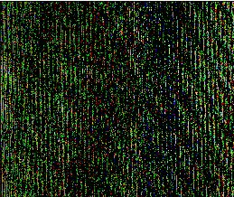
Failed Image 1
Output: I am using the images in the paper as my initial test case to replicate the algorithm in the paper. The output is just noises with no clear image.
Reason: I forgot to put 1 to in the diagonal items in the weight matrix A. Note: the colorized image is derived by solving the linear system: Ax = b

Slide 19
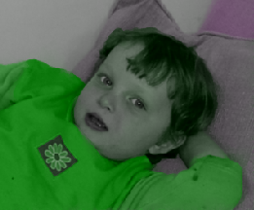
Failed Image 2
Output: I am using the images in the paper as my initial test case to replicate the algorithm in the paper. The output tends to more green.
Reason: When I convert YUV format to RGB format, I made a mistake in the code that all R, G, B set to be R.

Slide 20
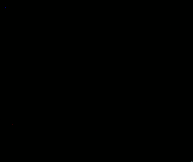
Failed Image 3
Output: I am using the images in the paper as my initial test case to replicate the algorithm in the paper. The output is all black ...
Reason: When I convert YUV format to RGB format, I made a mistake in the code that all R, G, B set to be R.

Slide 21
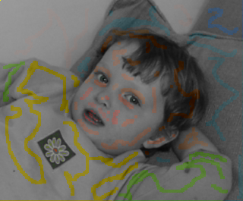
Failed Image 4
Output: I am using the images in the paper as my initial test case to replicate the algorithm in the paper. The output looks the same as the marked image
Reason: I forgot to update the row index, so that the weight matrix is not correct.

Slide 22
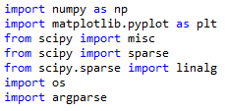
Computation: Code Functional Description
Part 1: To colorize still Image
Above is the list of libraries I used in my final project

Slide 23

Computation: Code Functional Description
Part 1: To colorize still Image
Step 1: As suggested in the paper, I first convert the image in the RGB format to YUV format, where Y is the intensity channel, and U and V channel include color information.

Slide 24
Computation: Code Functional Description
Part 1: To colorize still Image
Step 2: find the marked area with color scribbles. This is where there are differences in Y, U or V channel.

Slide 25
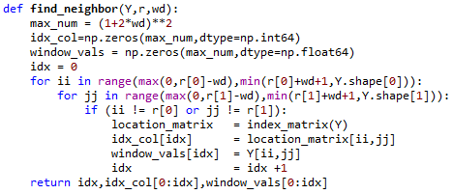
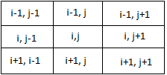
Computation: Code Functional Description
Part 1: To colorize still Image
Step 3: For each pixel r=[i,j] in the image, identify its neighbor with width 1 pixel.

Slide 26
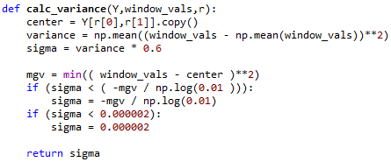
Computation: Code Functional Description
Part 1: To colorize still Image
Step 4: Calculate variance in the neighbor of each pixel [i,j]. The variance is required to calculate the weight matrix A

Slide 27

Computation: Code Functional Description
Part 1: To colorize still Image
Step 5: for each pixel r=[i,j], calculate the weight of each pixel in its neighbor based on equation 2 in the paper. The weights will be added into the weight matrix A, to form the linear system Ax = b.

Slide 28
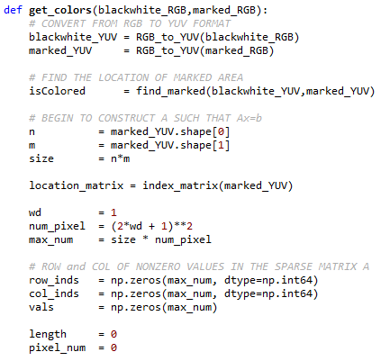
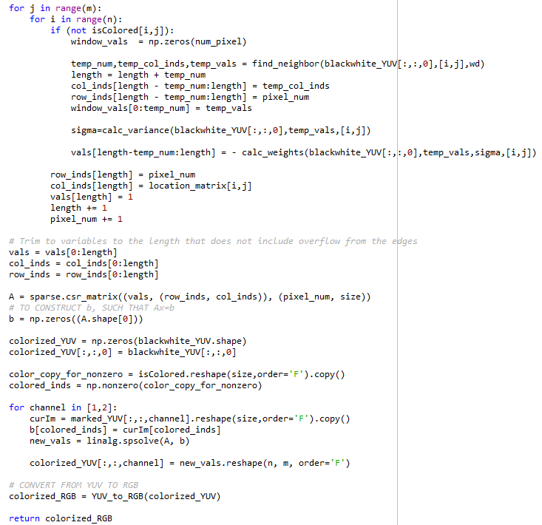
Computation: Code Functional Description
Step 6: Once derived the weight matrix A, the colorized image is calculated by solving the linear system Ax = b. The detailed algorithm is shown in the slides of development details.

Slide 29
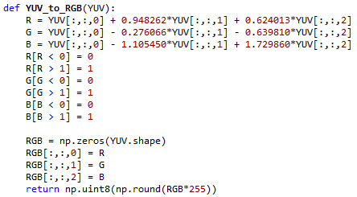
Computation: Code Functional Description
Part 1: To colorize still Image
Step 7: Convert the colorized image from YUV format back to RGB format, and save the output.

Slide 30

Computation: Code Functional Description
Part 2: To colorize black and white video clips
Step 1: given the image frames extracted from video clip, I first convert the color image into black-and-white images. That is I convert the image from RGB to YUV format, but only keep the Y channel (intensity channel) and ignore the U and V channels (color channels). Then convert back to RGB format.

Slide 31
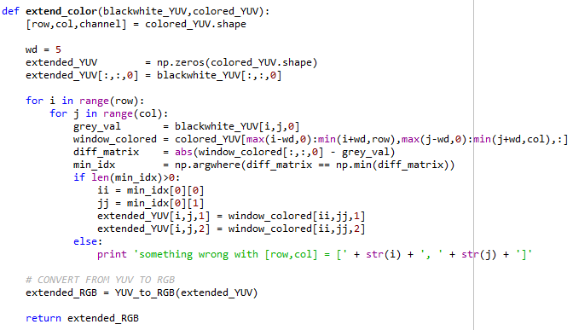
Computation: Code Functional Description
Part 2: To colorize black and white video clips
Given one gray frame and one colorized frame, for each pixel r=[i,j] in the gray frame, I compare its intensity value (Y channel) to intensity values in the neighbor of r with width 5 pixels of the colorized image. I identify the location in the colorized image s=[ii,jj], such that the different Y[r]-Y[s] is minimized in the neighbor of pixel r with width 5 pixels. Then let U[r] and V[r] values of gray image to equal to U[s] and V[s] of colorized image
gray_U[i,j] = colorized_U[ii,jj]
gray_V[i,j] = colorized_V[ii,jj]
Finally, I converted the YUV format back to RGB format
Step 2: After manually marking the black-and-white image using color scribbles, I used the get_color in part 1 to colorize the marked image. Then I extended the colorized image to its neighbor black-and-white images. In my test example, I marked and colorized 1 frame for every 10 frames, and extend the colorized frame to the next 9 frames. For example, I colorized the 0th image, and extend its color to frame 1, 2, ..., and 9

Slide 32
Resources
Source paper
Anat Levein, Dani Lischinski, Yair Weiss, Colorization using Optimization
https://www.cs.huji.ac.il/~yweiss/Colorization/colorization-siggraph04.pdf
Source matlab code
https://www.cs.huji.ac.il/~yweiss/Colorization/colorization.zip
Conversion from RGB to YUV and YUV to RGB
Jack, K. 2001, Video Demystified, 3rd edition ed. Elsevier Science & Technology
Duck image
https://i.ytimg.com/vi/vufs2Y1pFeQ/maxresdefault.jpg
Computational Photography @ GT

Slide 33
Resources
Cattle image
https://i.pinimg.com/736x/9f/c4/c6/9fc4c6ce00de0d4ffb3f98f9c7d4e852--cow-face-funny-cows.jpg
Rat image
https://cdn.vox-cdn.com/thumbor/tSvdZRmVKzBGDXujME9MSw1VqGo=/60x0:939x586/1280x854/cdn.vox-cdn.com/uploads/chorus_image/image/48349001/WINNER-Julian-Rad.0.0.jpg
Girl image from Youtube using screen shot
https://www.youtube.com/watch?v=HgmDCkkLQT0
Computational Photography @ GT

Slide 34
Appendix: Your Code
Code Language: Python 2.7
List of code files:
ReadMe.txt
Colorize_Img.py
Colorize_Video.py
Note: ReadMe.txt includes the instructions to run python code

Slide 35
Credits or Thanks
I would like to thank the following tool provider for my final project
Online converter from video to frames
http://www.filezigzag.com/Download/DT.aspx?T=107b8c2f-041a-4393-a14c-80fb36a684f5
RGB to YUV conversion formula
Jack, K. 2001, Video Demystified, 3rd edition ed. Elsevier Science & Technology
GIF maker
http://gifmaker.me/
Computational Photography @ GT

